Slide 1


Project management with Git Flow
Presentation by David Weis

Slide 2
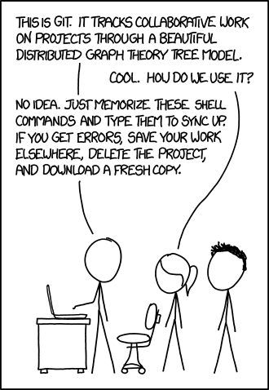
Git Commands
git init
git status
git add <filename> | -A
git commit –m
git pull
git push

Slide 3
git init
Starts a git repository in current directory
First command you use when creating a new repository
You’ll never need it again after the first time

Slide 4
git clone
git clone <link to remote repo>
Creates a local copy of the remote repository
Copy is placed in a folder with the name of the repository
If you want to work in it you have to cd into it

Slide 5
git status
Shows the current status of the repository
Prints exactly what’s in the staging area and which files have changed
It is best to type this obsessively!

Slide 6
git add
git add <filename>
Will add a single file to the staging area and prepare it for committing
git add –A
OR
git add *
Will add all changed or new files to the staging area

Slide 7
git reset
Will remove all files from staging area
git reset --hard
Will throw out all of your uncommitted changes! Dangerous!

Slide 8
git diff
git diff <filename>
Will print out what exactly has changed in that file

Slide 9
git commit
git commit
Creates a new commit with all changes that are added to the staging area
If you only type this, a text editor will open and you will have to write a commit message and then save and exit the editor.
git commit –m “commit message”
This makes the commit immediately with the message you’ve written.
This is what you will normally use

Slide 10
git pull
git pull
Will fetch all of the changes from the linked remote repository and try to merge them with your own files
If your files have been changed and conflict with the remote files, this might cause a merge conflict. Don’t worry, this is normal!

Slide 11
git push
“Uploads” all of your committed changes to the remote repository.
Only works when you are up to date with the remote repository.

Slide 12
Push and Pull
push – takes the local branch and “upload” it to the remote repo.
Push only uploads committed changes.
Push only uploads current branch.
There is an argument that will push all branches.
You always want to pull before pushing.
pull – downloads all changes from remote and merges them with local.
This may give you a merge error if there are conflicting changes on remote.

Slide 13
Git Resources
Git command line tutorial – Best starting place.
https://try.github.io
Pro Git – Perfect (and free!) e-book about Git.
Pro Git
First-Aid Git - Great place to look for quick solutions.
http://firstaidgit.io/#/
Git fix Um - Great place to search for solutions.
sethrobertson.github.io/GitFixUm

Slide 14


